Slide 1
CircleCI
Lecturer: Ngo Huy Bien
Software Engineering Department
Faculty of Information Technology
VNUHCM - University of Science
Ho Chi Minh City, Vietnam
nhbien@fit.hcmus.edu.vn

Slide 2

Objectives
To implement continuous integration using CircleCI.

Slide 3

Contents
Build Automation

Slide 4

References

Slide 5
1. Create Script
Register a GitHub account
Create a Node.js project with an empty test.
Create a .circleci/config.yml file.
Copy sample script ( https://circleci.com/docs/2.0/sample-config/ ) to the config.yml file
# Use the latest 2.1 version of CircleCI pipeline process engine.
# See: https://circleci.com/docs/2.0/configuration-reference
version: 2.1
orbs:
node: circleci/node@4.1
jobs:
build-and-test:
...

Slide 6
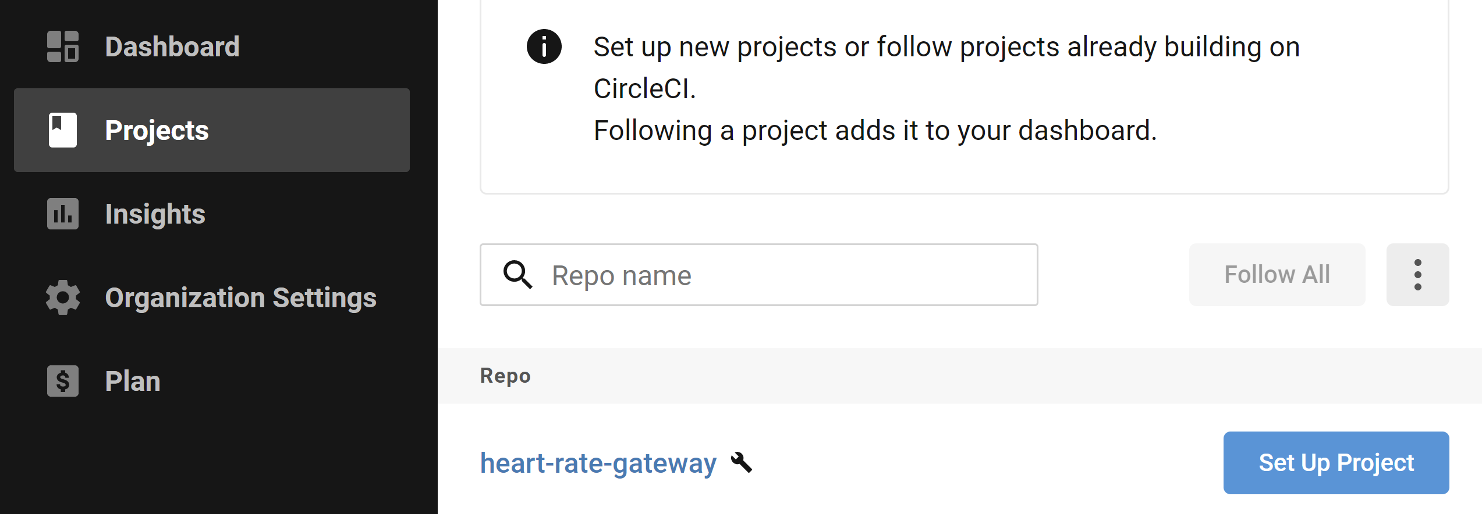
2. Log in CircleCI using GitHub Account
Commit the code to GitHub.
Log in https://circleci.com/ using the GitHub account.
Click on the Set Up Project button.

Slide 7
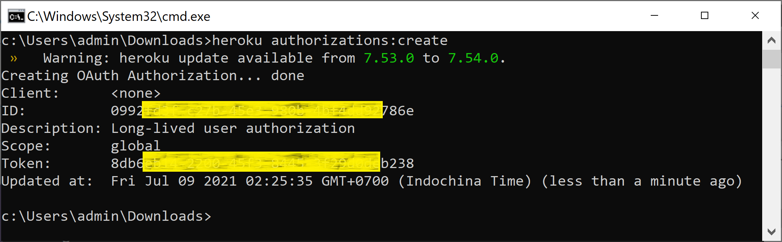
3. Create Heroku API Key
Register a Heroku account ( https://signup.heroku.com/ ).
Create a Heroku application. Note the application name.
Create a Heroku API key.
heroku authorizations:create

Slide 8
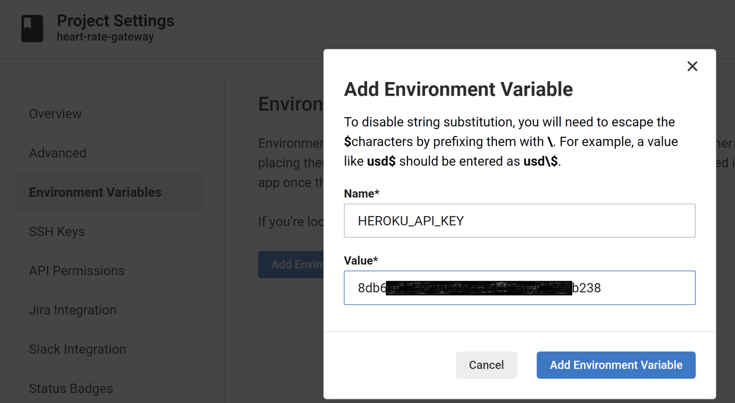
4. Set CircleCI Variable
Log in https://circleci.com/ using the GitHub account.
Select a project. Go to Project Settings → Environment Variables.
Add HEROKU_APP_NAME and HEROKU_API_KEY variables.

Slide 9
5. Modify CircleCI Configuration File
Modify the .circleci/config.yml file as below.
version: 2.1
orbs:
heroku: circleci/heroku@0.0.10
jobs:
build-and-test:
docker:
- image: cimg/node:15.1
steps:
- checkout
- node/install-packages
- run:
name: Run tests
command: npm test
workflows:
heroku_deploy:
jobs:
- heroku/deploy-via-git

Slide 10


Slide 11
1. Download .NET Project
https://circleci.com/docs/2.0/hello-world-windows/
Register a GitHub account.
Download HelloWorld project.
https://github.com/CircleCI-Public/circleci-demo-windows
del .gitignore
del README.md
git init
git pull https://github.com/[Org.Name]/IMP.git master
git add *.*
git commit -m "CI/CD demo files added"
git remote add origin https://github.com/[Org.Name]/IMP.git
git push origin master

Slide 12
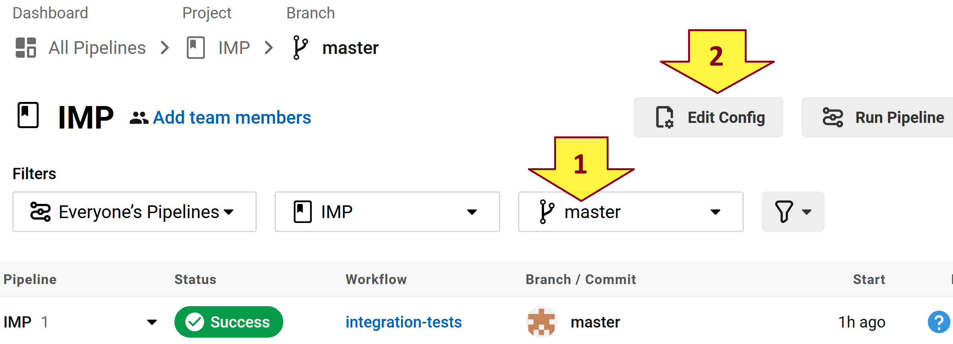
2. Set Up .NET Project in CircleCI
Log in https://circleci.com/ using the GitHub account.
Click on the Set Up Project button.

Slide 13
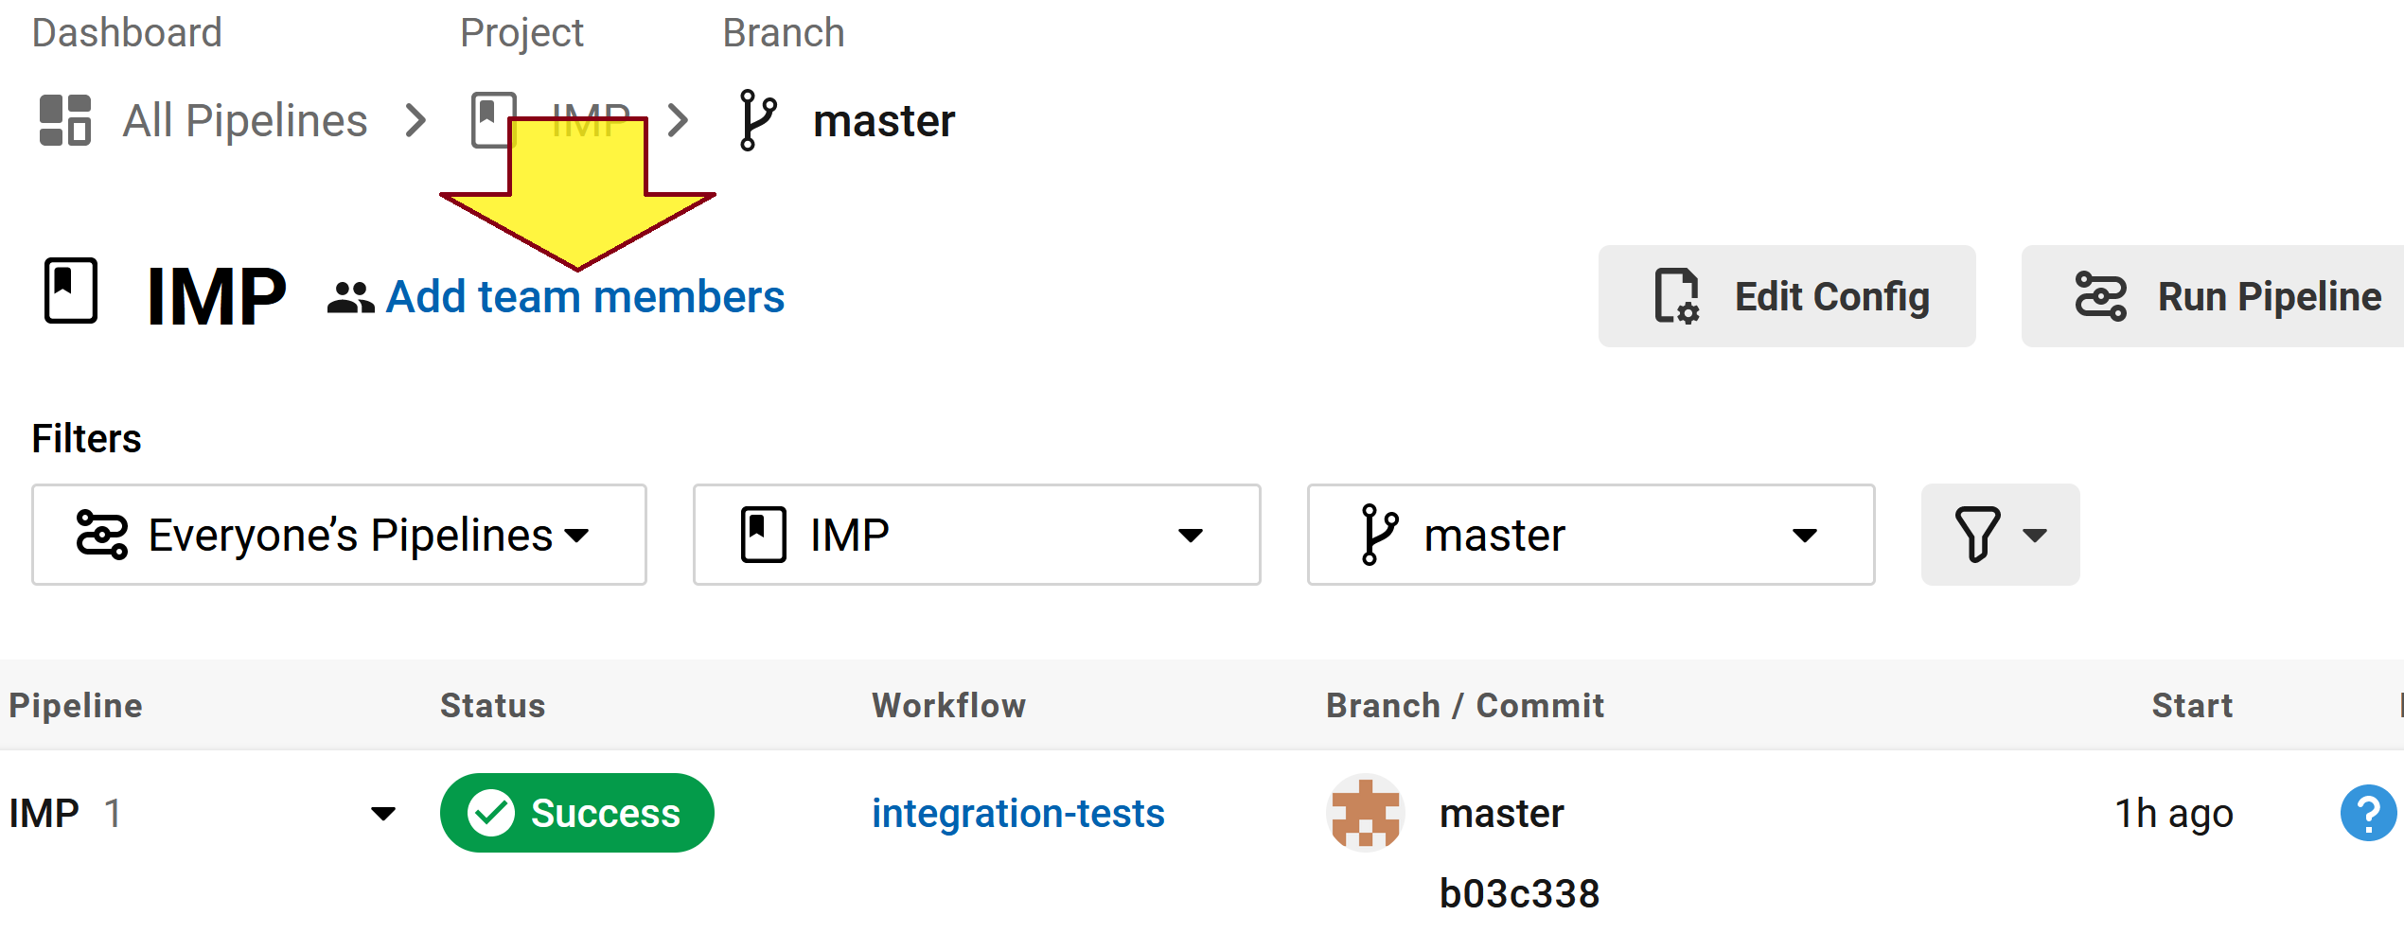
3. Invite a Team Member

Slide 15
Travis CI
https://www.travis-ci.com/

Slide 16

Thank You & See You Again

